Slide 1
Sunshine Scoop
Good!
NEWS!
Sunshine Scoop: Your Daily Dose of Positivity!
Presented by Shinu Joseph and Cem Akuras

Slide 2
TABLE OF CONTENTS
01
04
02
05
03
Introduction
Data Cleaning
Data Extraction
Next Steps
Data Understanding

Slide 3

Introduction
About Us : We are The Fine Tuners.
Mission : Spreading joy through positive news, Sunshine Scoop inspires optimism and brighter perspectives every day.
No more BAD NEWS!
Sunshine Scoop stands against the belief bad news sells. Our motto is ``No More Bad News! ``.

Slide 4






Introduction
Purpose : To create a positive news aggregator.
Project Milestones :
Choose one or more news portals for data extraction.
Implement sentiment analysis and filter out articles with negative or neutral sentiments.
Choose a summarisation algorithm and generate concise summaries for each news article.
Develop a web application for publishing the summarised, positive news.
Tools :
Collaboration and Version Control : Git, Click Up, Whatsapp
Programming language : Python
Code editor : VSCode, Jupyter Notebook
Web app development : Flask

Slide 5
Data Extraction
Website Used : www.today.com [archives for November 2023]
Library : Scrapy - Web crawling and Web scraping framework for Python
Steps :
What's happening: Web Crawling and Scraping Technique
The Tool Used: Scrapy as helper program
Setting Up the Project:Webscrapy project
Creating a Web Explorer (Spider): Web explorer named "today_spider."
Starting the Exploration: Looking at today.com
Figuring Out What's on the Pages (Parsing): Special method called "parse."
Saving Stuff: CSV file to organise data
Notes:
What's happening:
We're using a technique called web scraping to get information from a website, specifically news articles from today.com.
The Tool Used:
We're using a package called "Scrapy," which is like a helper program written in the Python language.
Setting Up the Project:
We created a space to organize our web scraping work, and we call it the "today new crawler"
Creating a Web Explorer (Spider):
Inside our project, we made a little web explorer, and we named it "today_spider"
Starting the Exploration:
We told our web explorer to start looking at today.com to find news articles.
Figuring Out What's on the Pages (Parsing):
As our explorer goes through the website, it's smart enough to understand what's on each page. We do this using a special plan or method called "parse."
Saving the Good Stuff:
Explorer first copy the link from archive, then it takes title after that explorer gets inside of the link and copy the content. In our case, it's saving this information like a list in a CSV file, which is a simple way to organize data.
So, in simple terms, we're using a tool (Scrapy) to send a little explorer (spider) to today.com to find news articles, and each time it finds one, it writes it down in a special file (CSV). That's the basic idea!

Slide 6





Data Understanding
News Data
Data Size
1190 Rows
3 Columns :
Link
Title
Content
Data Format
CSV File
Data Quality
0 missing value
3 duplicates in content column
1 duplicate in title column
Data Types
Text
Notes:
At Data Understanding part we worked on a CSV file which has 1190 rows and 3 columns, 0 missing values and 3 duplicated content rows.

Slide 7
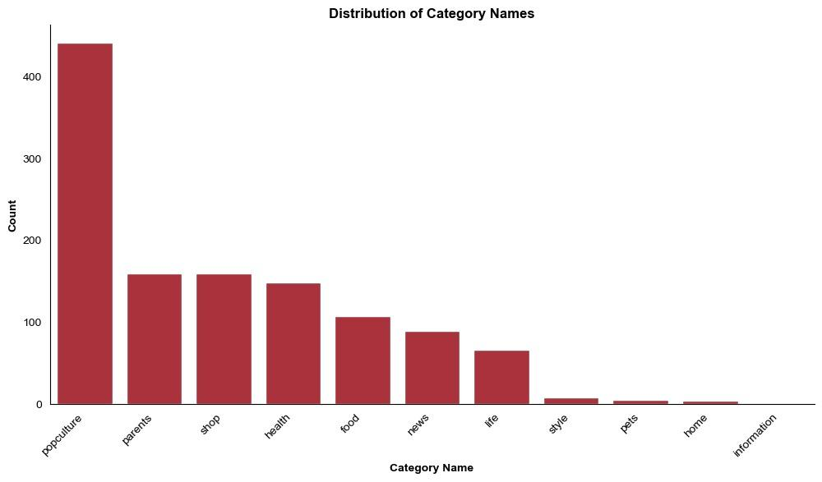
Data Understanding
11 Categories
Popculture
Parents
Shop
Health
News (Latest Stories)
Life
Style
Pets
Home
Information
Notes:
We analysed that our dataset has 11 categories in our data which are pulled from link column. Analysis and outputs changes by category of the data. Additionally, categorised data provides more opportunities for in-depth data analysis.

Slide 8
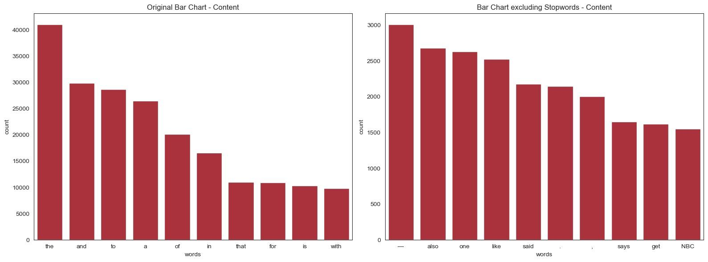
Data Understanding
Most common words
Most common words without stopwords
Notes:
Most common words are checked to understand the content, identify key terms, to see the quality of text and understand language style.
Where first graph is showing most common words, second graph is giving information with excluding stopwords because removing stopwords helps to reduce noise and can improve the efficiency of processing and analyzing text.

Slide 9
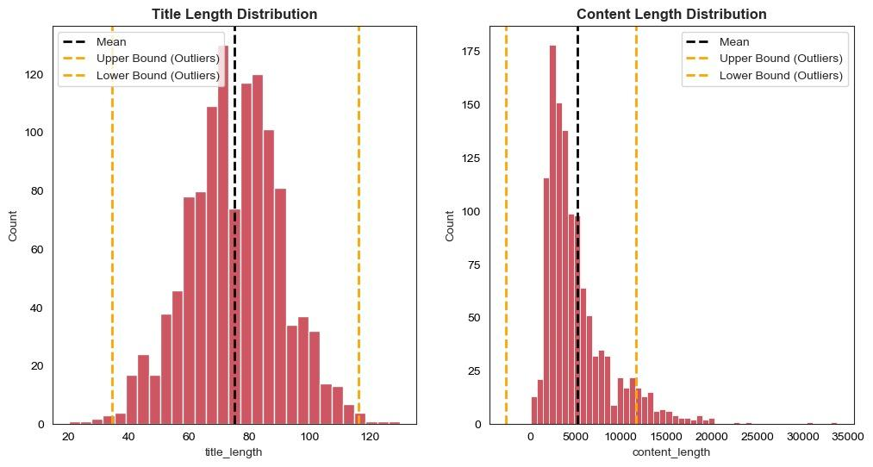
Data Understanding
Normally Distributed Title Length
11 outliers for Title
Right Skewed Content Length
87 outliers for Content
Notes:
Authors tend to use titles of varying lengths, and there is no strong bias towards extremely short or long titles.
Content length indicates that the majority of articles have shorter content, and there are fewer articles with exceptionally long content.
These distributions tell us that news articles often have short headlines, allowing readers to quickly grasp the main idea.
However, content lengths show a trend towards shorter articles. This is probably due to the need to appeal to readers with limited time or the preference for short information.

Slide 10
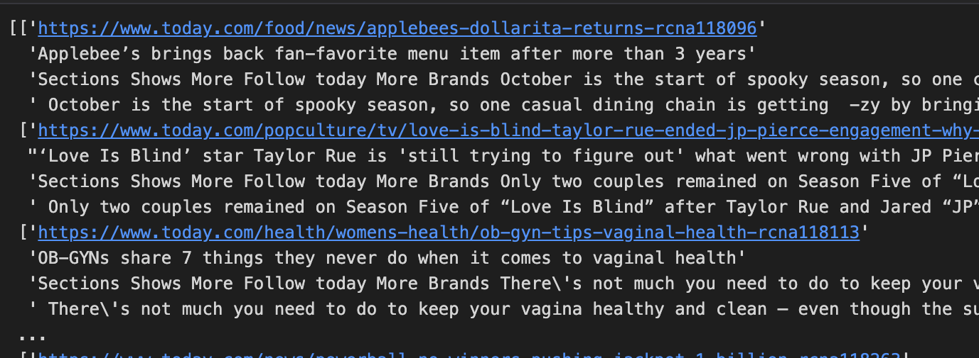

Data Cleaning
Removed a particular substring from the column “content”
Performed using regex expressions.
Removed emojis and non-breaking space
Before [non-breaking space] :
3 Duplicate rows removed
After [non-breaking space] :

Slide 11
Next Steps
Decide on a sentiment analysis model.
Implement sentiment analysis, filter out positive and neutral sentiments.
Prior to summarisation, determine how to divide text into paragraphs considering the token limits.
Choose a summarisation algorithm and generate concise summaries for each article.

Slide 12
Thank You!

